Slide 1




Summer Internship
2024

Slide 2


AMAN Summer Internship
Name: Menna Elminshawy
University Major: Data Science
Internship duration: 2 Month
Department: Data Engineering
Business unit: Data Department

Slide 3

Data Engineering

Slide 4
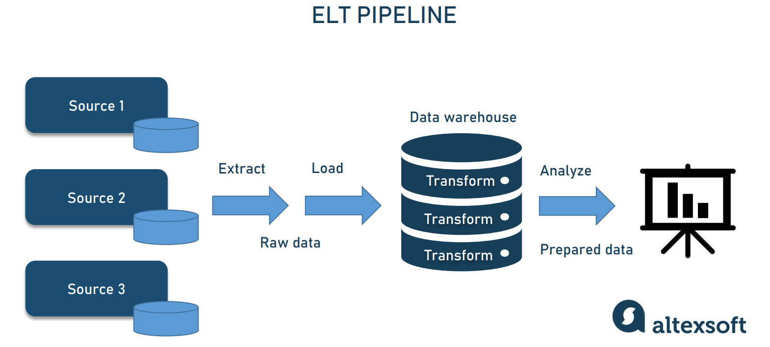
Projects & Learning experience

Slide 5
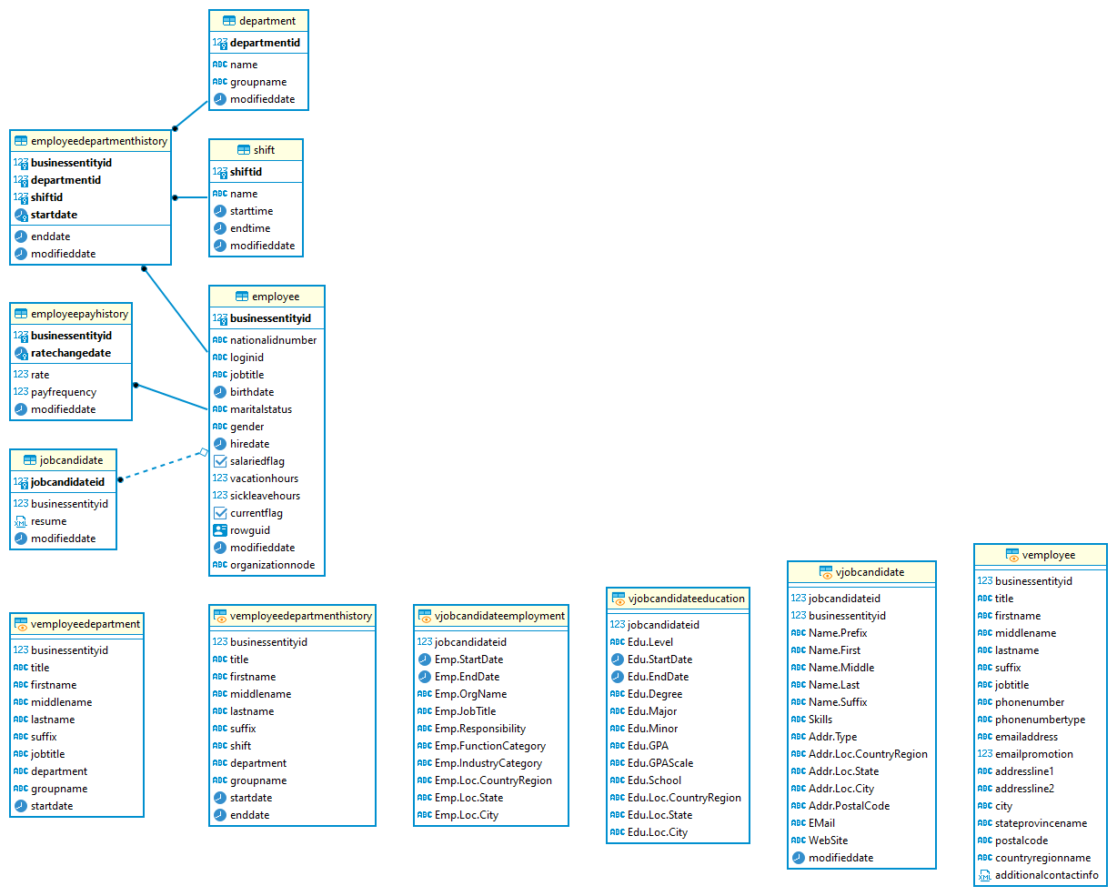
AMAN Summer Internship

Slide 6
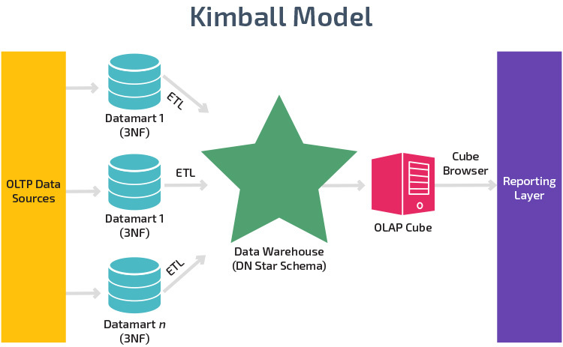
AMAN Summer Internship
The four key decisions made during the design of a dimensional model include:
Select the business process.
Declare the grain.
Identify the dimensions.
Identify the facts.

Slide 7
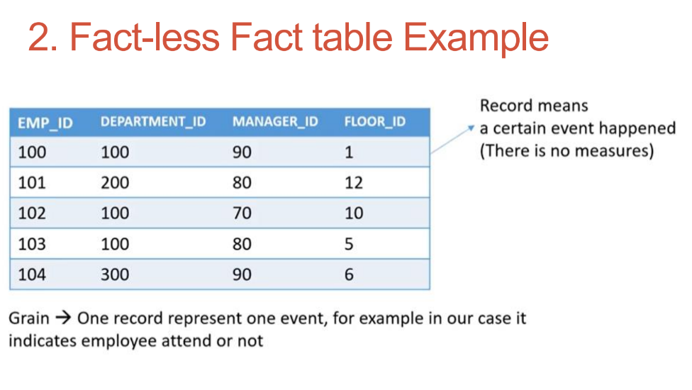
AMAN Summer Internship

Slide 8
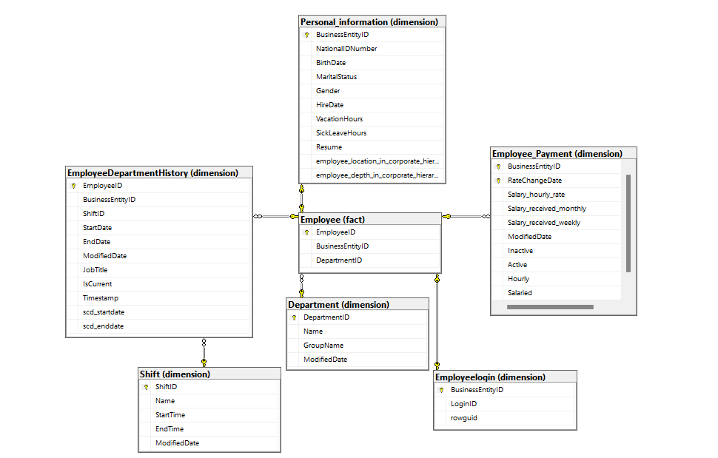
AMAN Summer Internship

Slide 9
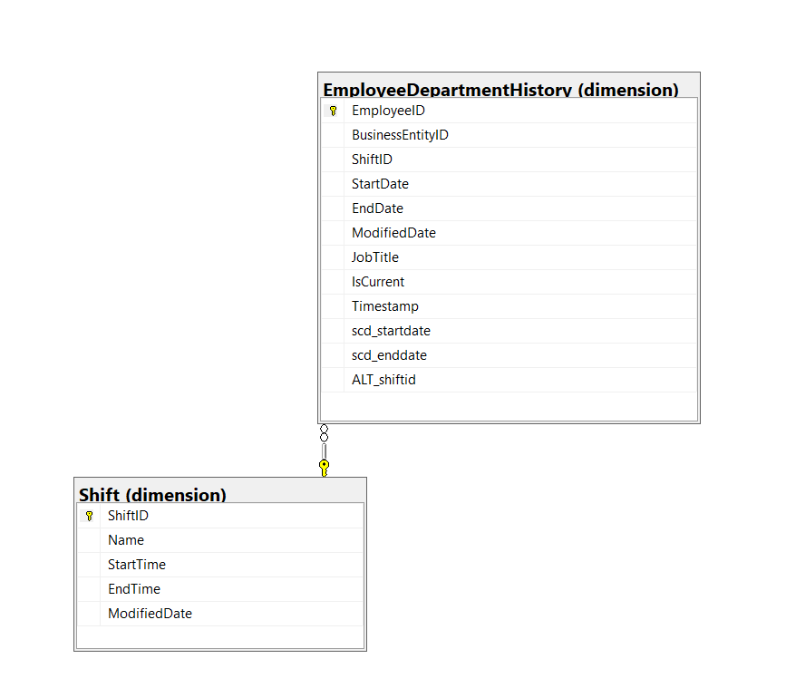
AMAN Summer Internship

Slide 10
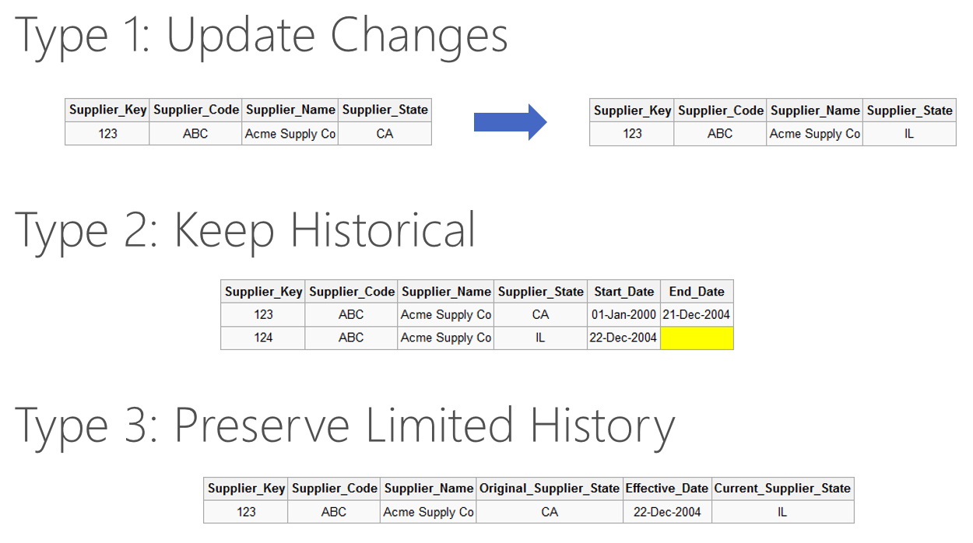
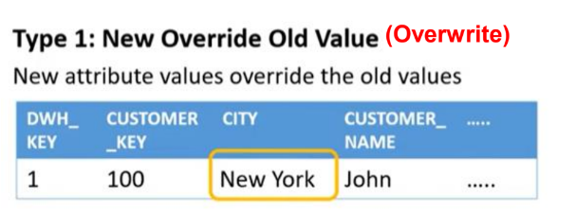
Slowly Changing Dimension (SCD) Type 1

Slide 11
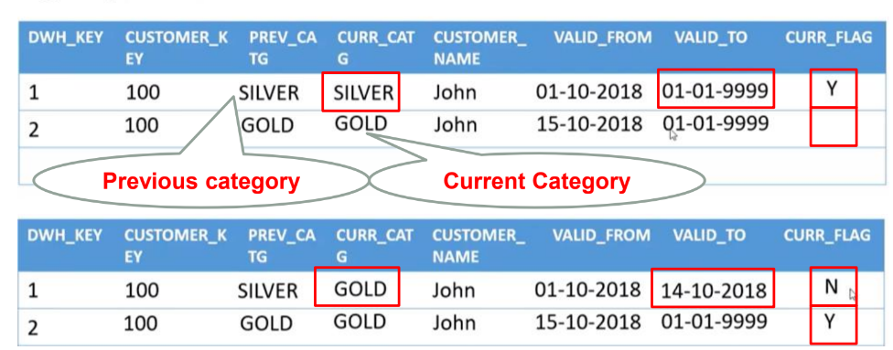
Slowly Changing Dimension (SCD) Type 2

Slide 12
Slowly Changing Dimension (SCD) Type 2

Slide 13
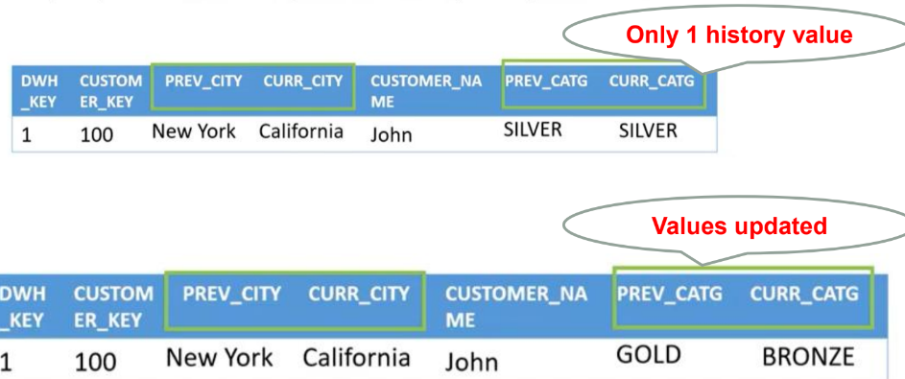
Slowly Changing Dimension (SCD) Type 3

Slide 14
Slowly Changing Dimension (SCD) Type 3

Slide 15
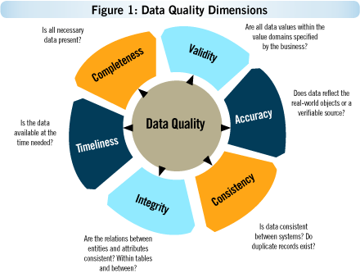
AMAN Summer Internship

Slide 16
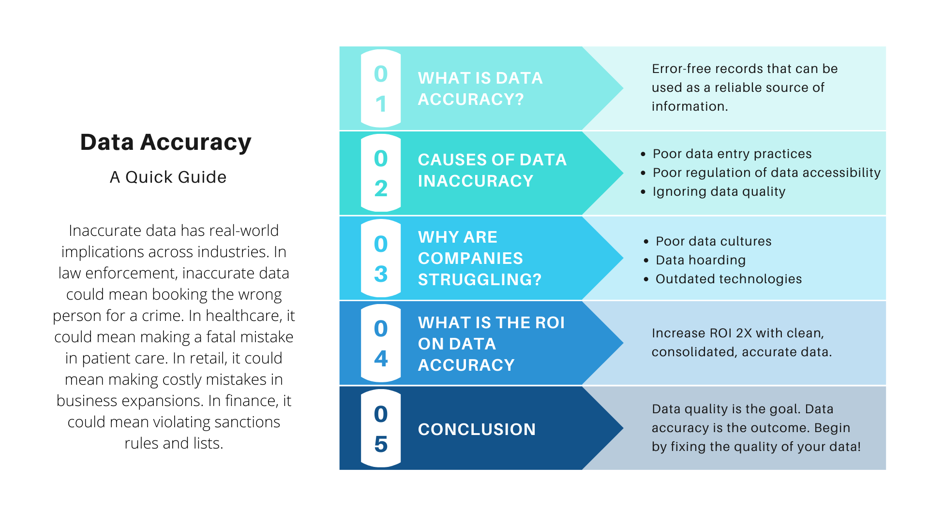
Accuracy

Slide 17
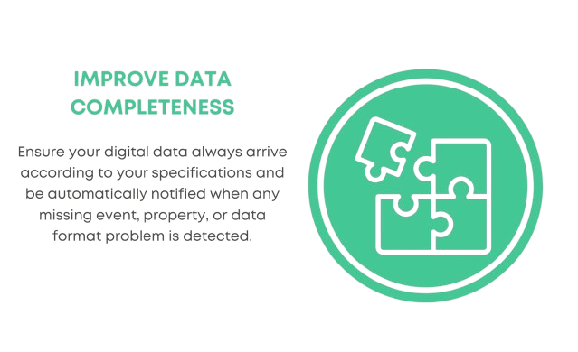
Completeness

Slide 18
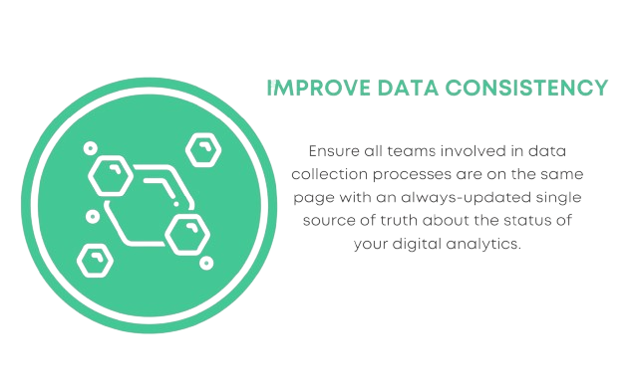
Consistency

Slide 19
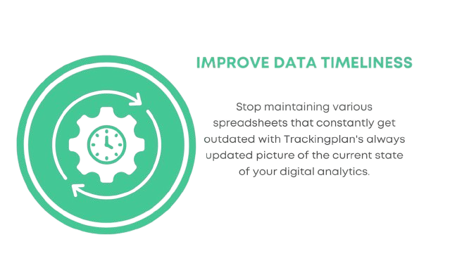
Timeliness

Slide 20
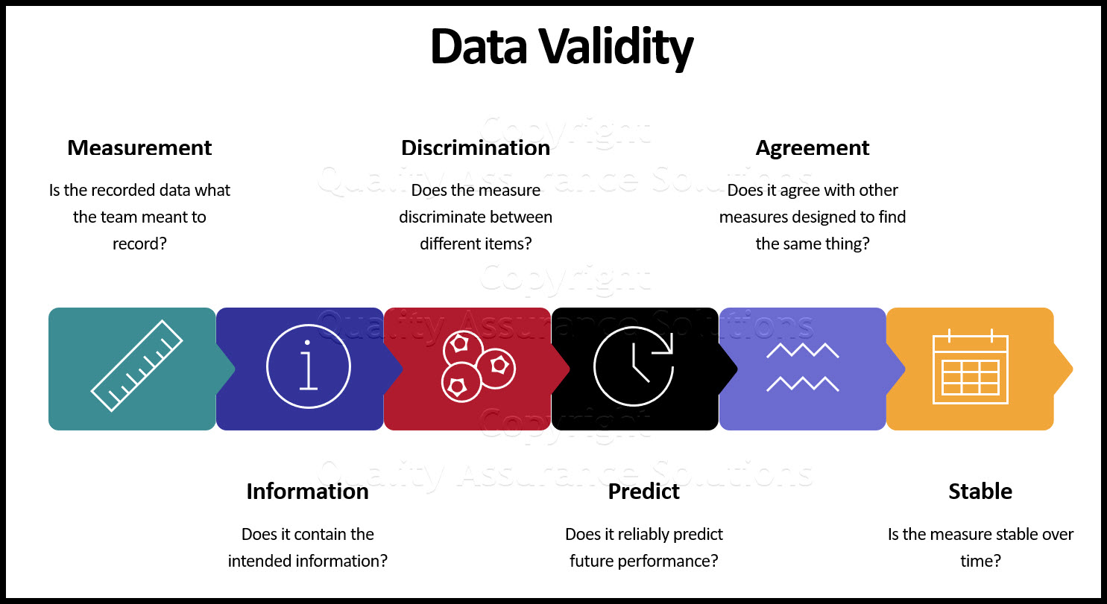
Validity

Slide 21
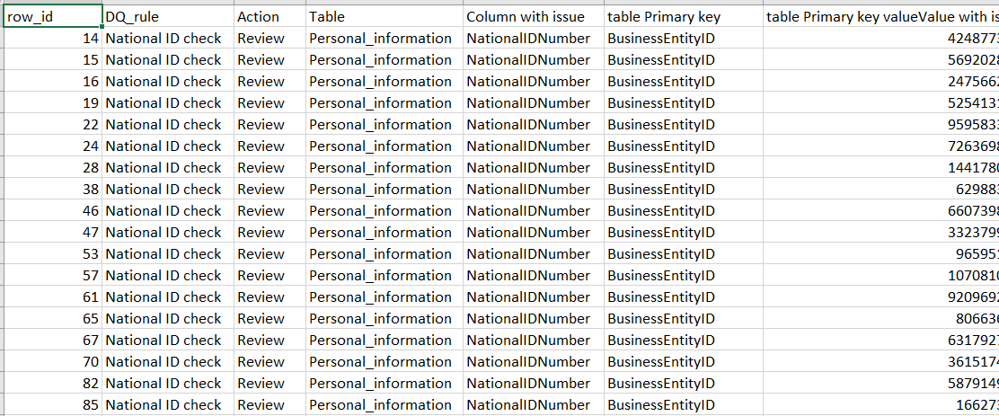
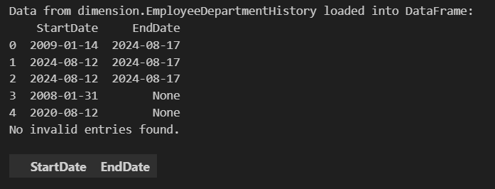
Validity
Validity is a data quality dimension that refers to information that doesn’t conform to a specific format or doesn’t follow business rules
Example :
Invalid National ID
Check Negative Salary
Extract Validate Data

Slide 22

Uniqueness

Slide 23

Send An Email With The Error

Slide 24
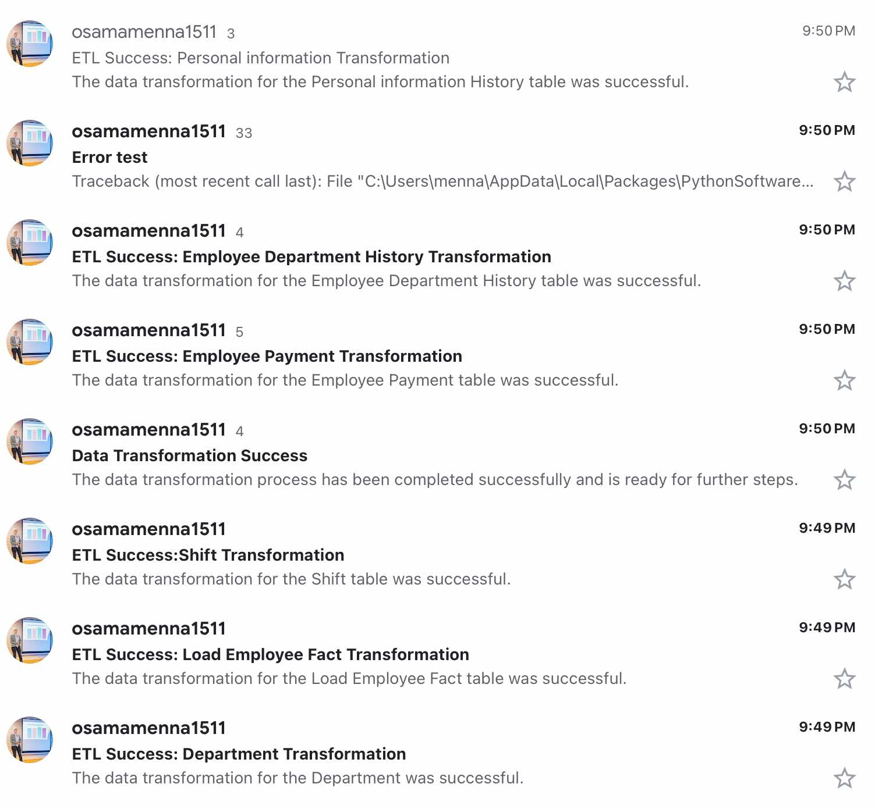
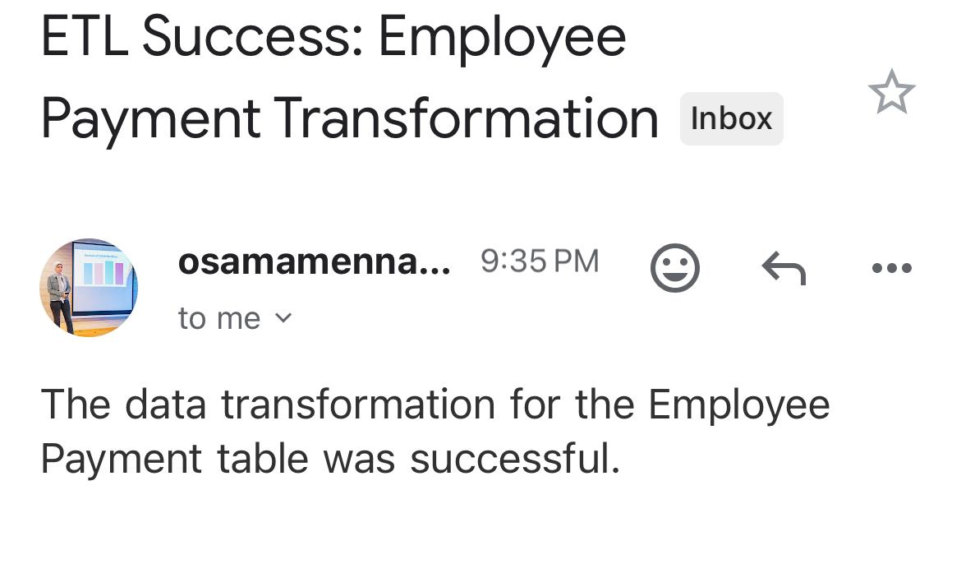
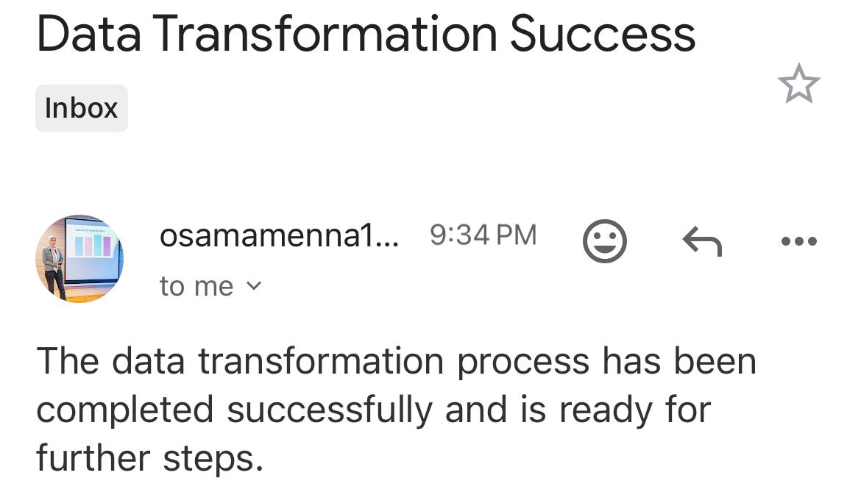
Send An Email With The Error

Slide 25


Thank You
2024

